Slide 1

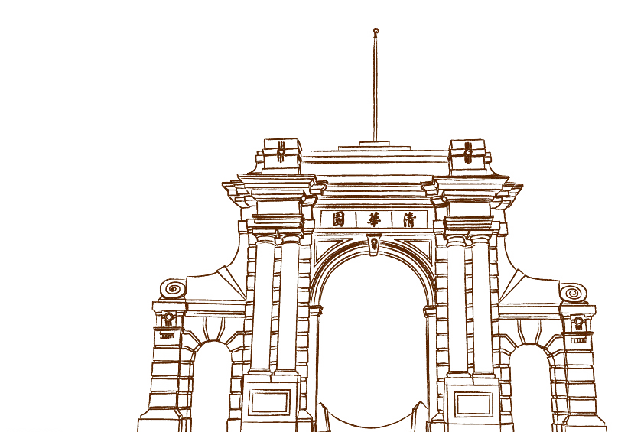
Rayscape: Report for Advanced Computer Graphic Project
By Zhicheng Tang

Slide 2
Basic ray tracing algorithm
To compute the color of a pixel, a ray is cast from the camera through the pixel into the scene. At the closest intersection point, direct lighting is evaluated. The material properties then determine whether the ray continues via reflection, sampled using Russian Roulette, until the depth reaches some constant.
Metallic surfaces yield a higher probability of reflection, whereas rougher materials result in a lower reflection probability, modulating the trade-off between direct illumination and recursive ray contributions.
In every sampling phase, a random point inside the pixel is chosen instead of the center for anti-aliasing.

Slide 3
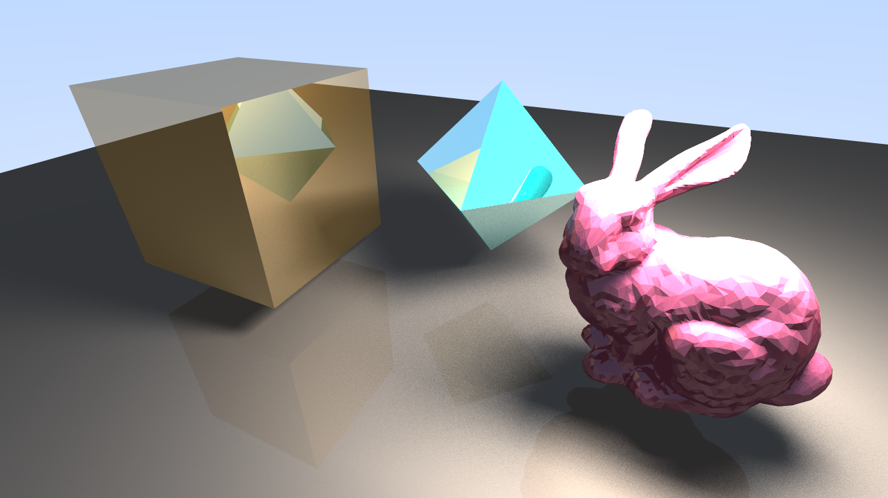
Basic ray tracing algorithm

Slide 4
Light sources
The rendering framework supports two fundamental types of light sources: Point Lights and Area Lights.
For Point Lights, the contribution to a surface is computed by first performing a shadow test to determine visibility. If the light is visible, the direct illumination is evaluated through a three-component model: diffuse reflection based on the surface's base color and roughness, specular highlights modulated by metallic properties, and ambient lighting for indirect fill.

Slide 5
Light sources
For Area Lights, the lighting calculation is extended to simulate extended light sources using the idea of importance sampling. Multiple points are sampled across the light's surface area, each treated as an individual point light. The contributions from all samples are accumulated, providing soft shadows and more realistic illumination gradients that better approximate physically based lighting.

Slide 6
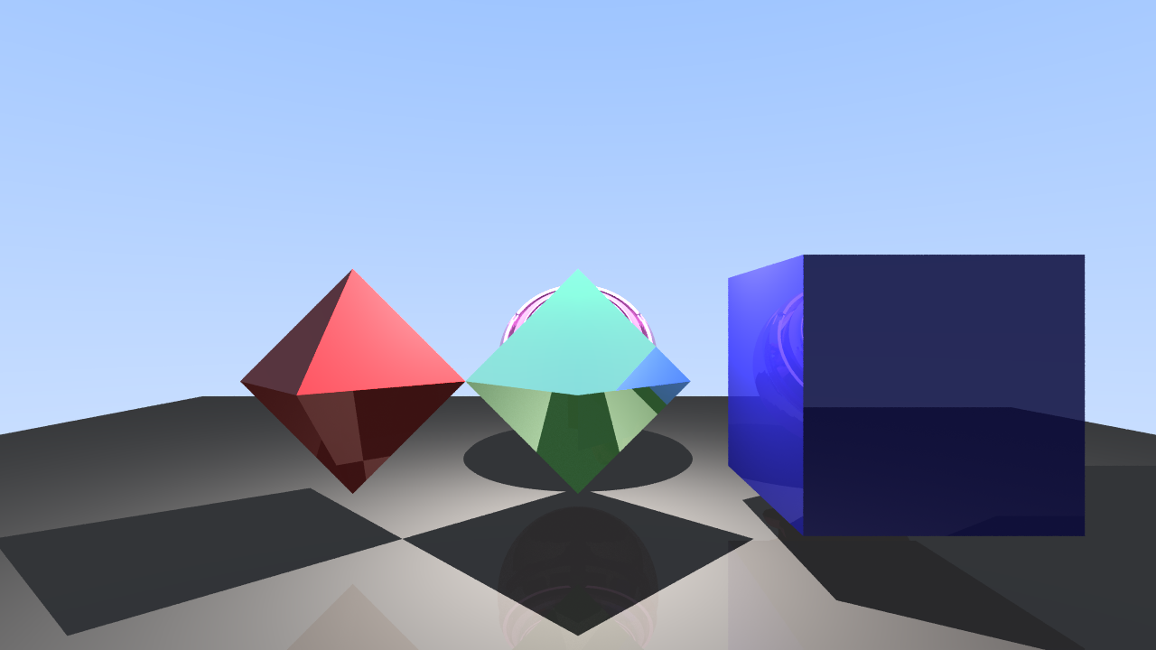
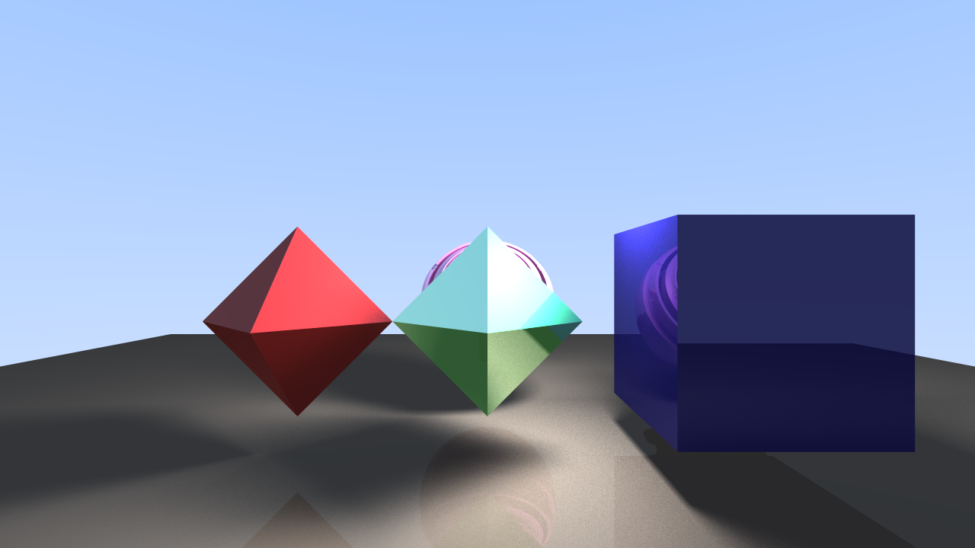
Light sources

Slide 7
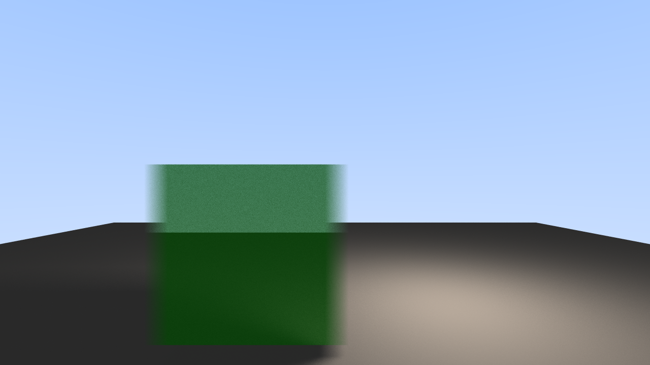
Motion Blur
Entities are extended with a velocity property, enabling dynamic motion within the scene. During each rendering frame, the transformation matrix of every entity is updated based on its assigned velocity, allowing for real-time animation and interactive object movement without requiring manual per-frame position adjustments.

Slide 8
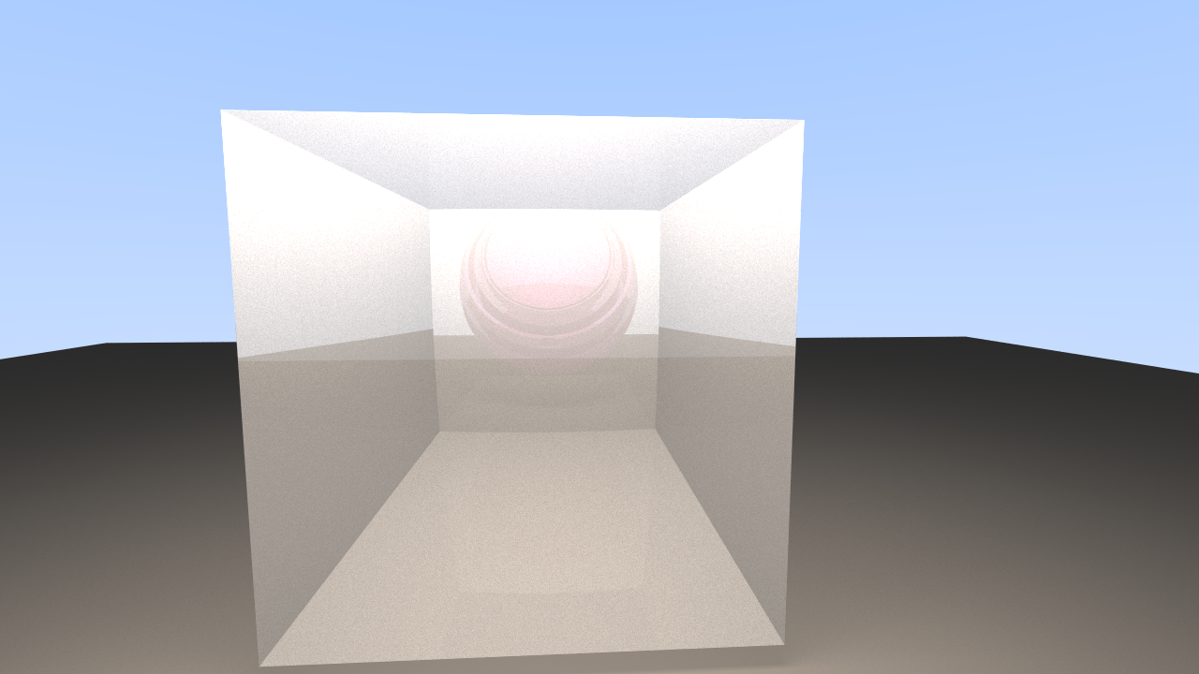
Transmissive material
To support transmissive materials, each material is extended with two key physical parameters: transmission factor and index of refraction (IOR). When a ray intersects a surface with a non-zero transmission value, a probabilistic decision is made—guided by Russian Roulette—to determine the ray's behavior: reflection, refraction, or absorption. This decision is weighted by the material's transmission factor, metallic properties, and surface roughness.

Slide 9
Thanks for your listening!

